Slide 1
Process Safety Challenges in Tech Transfer: A Case Study
P2SAC
Gareth Thomas & Brad Silva
2026
Oct 31st, 2024

Slide 2
Gareth Thomas
Brad Silva
Education
University of Alabama – Chemical Engineering, B.S.
Technical Focus Areas
Reaction Calorimetry
Process Safety
Reactive Chemical Hazards
Risk Management
DEKRA(Seattle, WA)
Reactive Chem BDM
Previous Experience
• Boeing
• General Dynamics
• Evonik
Education
University of Otago, Dunedin, New Zealand
PhD, Organic Chemistry — Organic Chemistry
Postgraduate Diploma, Hazard Assessment & Management
Technical Focus Areas
Crystallization
Process safety and scale‑up
Tech Transfer into manufacturing
Energetic and exothermic reaction control
Risk‑based development and hazard assessment
Phlow Corp (Richmond, VA)
Director Process Chemistry (MS&T)
Senior Principal Scientist (MS&T)
Previous Experience
• GlycoSyn (Wellington, New Zealand
• Donaghy's Ltd. (Dunedin, New Zealand)
• SAFC Pharma (Milwaukee, WI)
• Cambridge Major Labs (Germantown, WI)

Slide 3

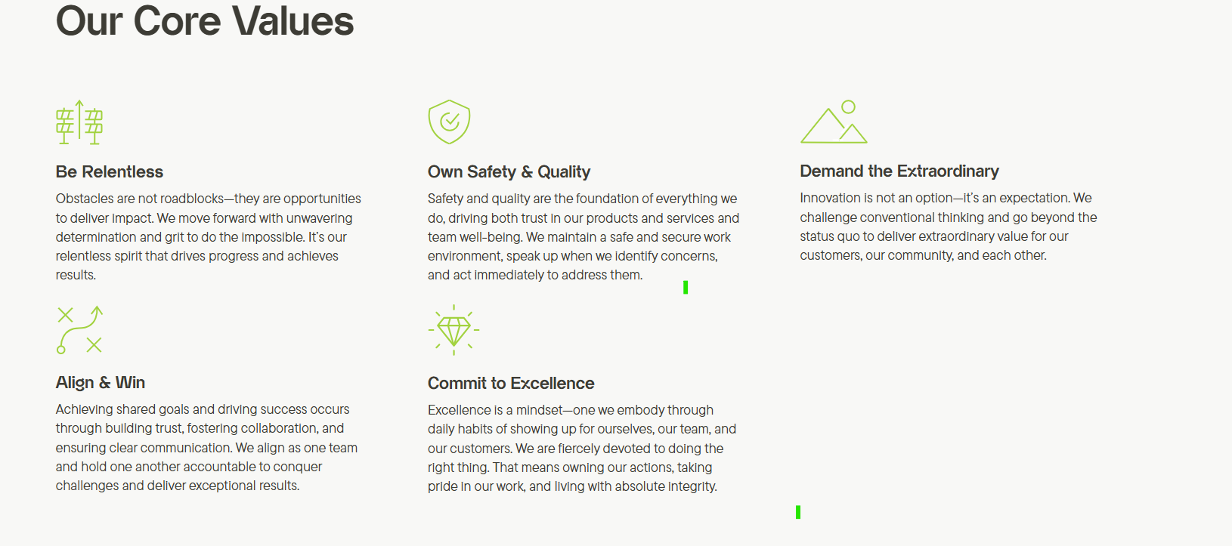
.
Notes:
CDMO, government and Industry Contracts.
Founded 2019: Eric Edwards MD PhD (CEO) and Prof. Frank Gupton (VCU School Engineering, CEO Medicines for All)
Petersburg Plant finished construction August 2024.
First API manufacture complete in Feb 2025 (kilo Scale)
First Flow Project complete Feb 2026 (4 steps in Flow 2 in Batch, Kilo Scale)
First Metric Ton project slated to fun Q3 and Q4 2026

Slide 4
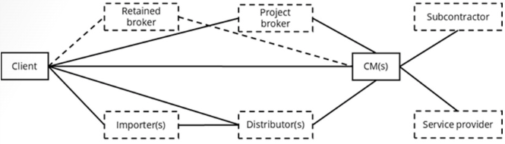
Challenges of Process Safety in the CDMO environment
Aggressive timelines
Rapid Technology Transfer and Scale up Risk
Limited resources
Diverse Client Processes
Regulatory Compliance
Managing High potency API (HPAPI)
Resource and expertise constraints
Data Integration and Risk Visibility
  CCPS Monograph – PS in Outsourced Manufacturing Operations
Notes:
“Aggressive timelines”
Transitioning from mg to g to kg on protracted timelines
Process Safety professionals in API world are scarce
Process Safety may be non-existent.
Will the client pay for it, or will the company absorb it?
cGMP is usually not negotiable, but neither is safety or environmental considerations.
API of increasing potency are now the rule not the exception
Correct interpretation of test results and application of Risk assessment/mitigation is a specialized skill
Equipment is generally not a project specific cost, and thus require company CAPEX expenditure
Transfer of data into manufacturing is not seamless.
Risk visibility may be low because of this.

Slide 5
Technology transfer and common data gaps
Technology Transfer
What is the largest scale this was previously run at?
Process Description
  Mass Balance
  Hazards
  Reaction profile
  Isolated materials characteristics
Process Safety Events (PSE)
Definition of deliverables.
Gaps
Data Sharing
Equipment compatibility
Safety assessments
Scalability and manufacturability
Understanding of risk
What the route not patented for a reason?

Slide 6
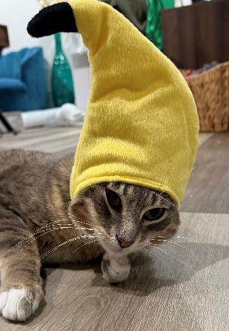

Scale vs Risk
How Scale up reveals risk
House cat vs tiger
Control effectiveness decreases
Consequences severity increase
Assumptions break down
Thermal inertia increases
What we tools we use change with scale

Slide 7
Risk-Based Data Collection
Route selection
Inherently Safer Design
Process Safety Culture
Software tools
Lab Scale
DSC/TGA/HF Cal
Pilot
Reaction Calorimetry
Adiabatic Calorimetry
Risk Assessments
Production
Vent Sizing testing & Calculations
Release modeling
Consequence analysis

Slide 8
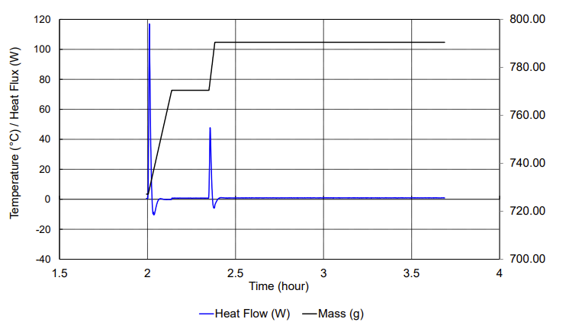
Case Study – RC-1 testing
Data collection
Tech Transferred – Exotherm not identified
Lab noticed a self sustaining exotherm
Involved flammables
Significant scale up moment
Isothermal and Adiabatic calorimetry

Slide 9
How the information from DEKRA was used at Phlow
VSP and RC-1 data was used to greenlight a proof-of-concept batch of the API at several 100 kg scale
  Operations were assured that this process was safe to apply in the existing equipment train
  A risk mitigation strategy was in place if engineering controls were unsuccessful
  Gaps in institutional knowledge were identified.
  Subsequent programs were treated with the same urgency as this one had been
  Path to independence for early phase screening was undertaken

Slide 10
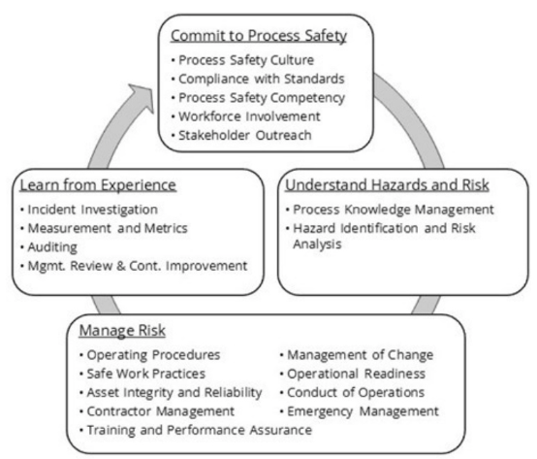
Building a Process Safety Culture at Phlow….
Process safety is not negotiable
Sharing responsibility and empowering decision making
Putting processes into place
Education of collogues
Education of management
Education of clients
Continuous improvement
  CCPS Monograph – PS in Outsourced Manufacturing Operations

Slide 11
Conclusions
Build engagement with development teams
Keep and open mind during tech transfer
Leverage all the tools available

Slide 12
Questions

